Slide 1
ER-Diagram
Unit-2 Cont…

Slide 2
Company Management System
Organization has multiple departments
Employees work for the department and manages the department
Per department there is an supervisor (an employee)
Department executes different projects
Employees work on those projects on hourly basis
Organization manages the information of the Employee’s dependents also.

Slide 3
Weak Entity Types
An entity that does not have a key attribute
A weak entity must participate in an identifying relationship type with an owner or identifying entity type
Entities are identified by the combination of:
A partial key of the weak entity type
The particular entity they are related to in the identifying entity type
Example: 1
A DEPENDENT entity is identified by the dependent’s first name, and the specific EMPLOYEE with whom the dependent is related
Name of DEPENDENT is the partial key
DEPENDENT is a weak entity type
EMPLOYEE is its identifying entity type via the identifying relationship type DEPENDENT_OF
Example: 2
ORDER (Strong Entity) and ORDERITEM (Weak Entity).
An OrderItem cannot exist without an Order.
Partial key: ItemNumber within an order.
Weak relationship: "Contains" between Order and OrderItem.

Slide 4
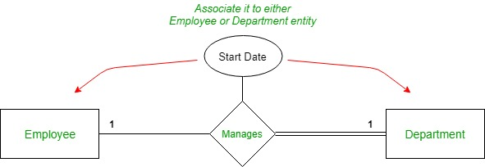
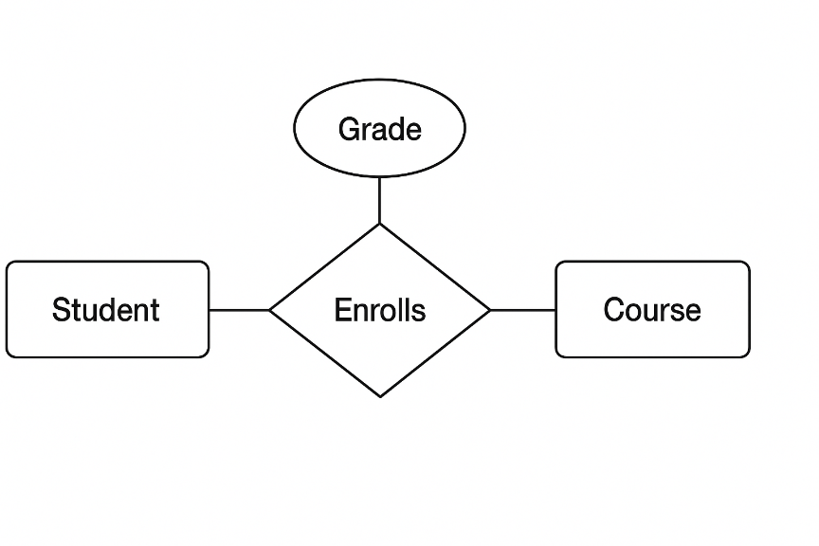
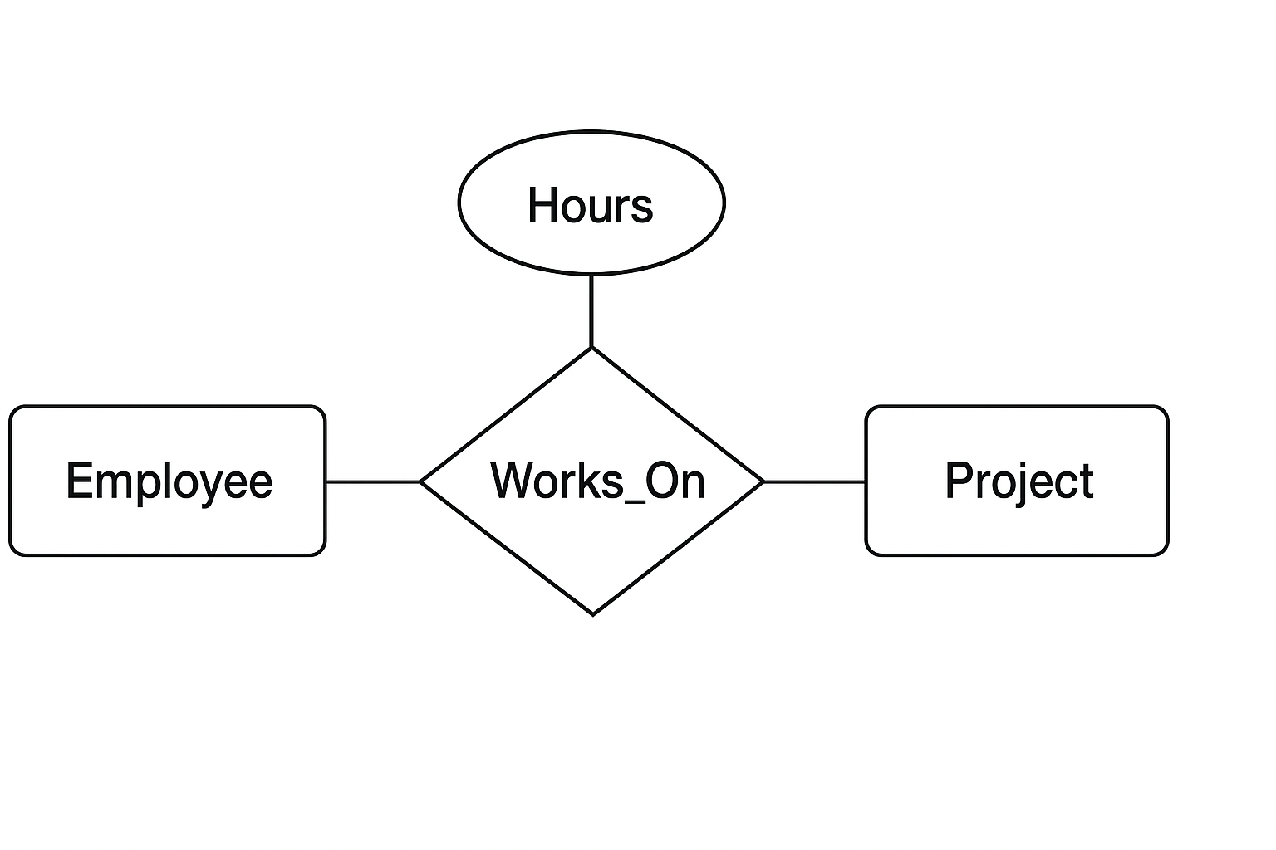
Relationship Type Attribute
Relationship attribute is a specific characteristic or property of that relationship itself, providing more detail about how the entities are connected
Doctor -------- Treats(Date_of_Treatment) -------- Patient
Employee -------- Works_On(Hours) -------- Project

Slide 5
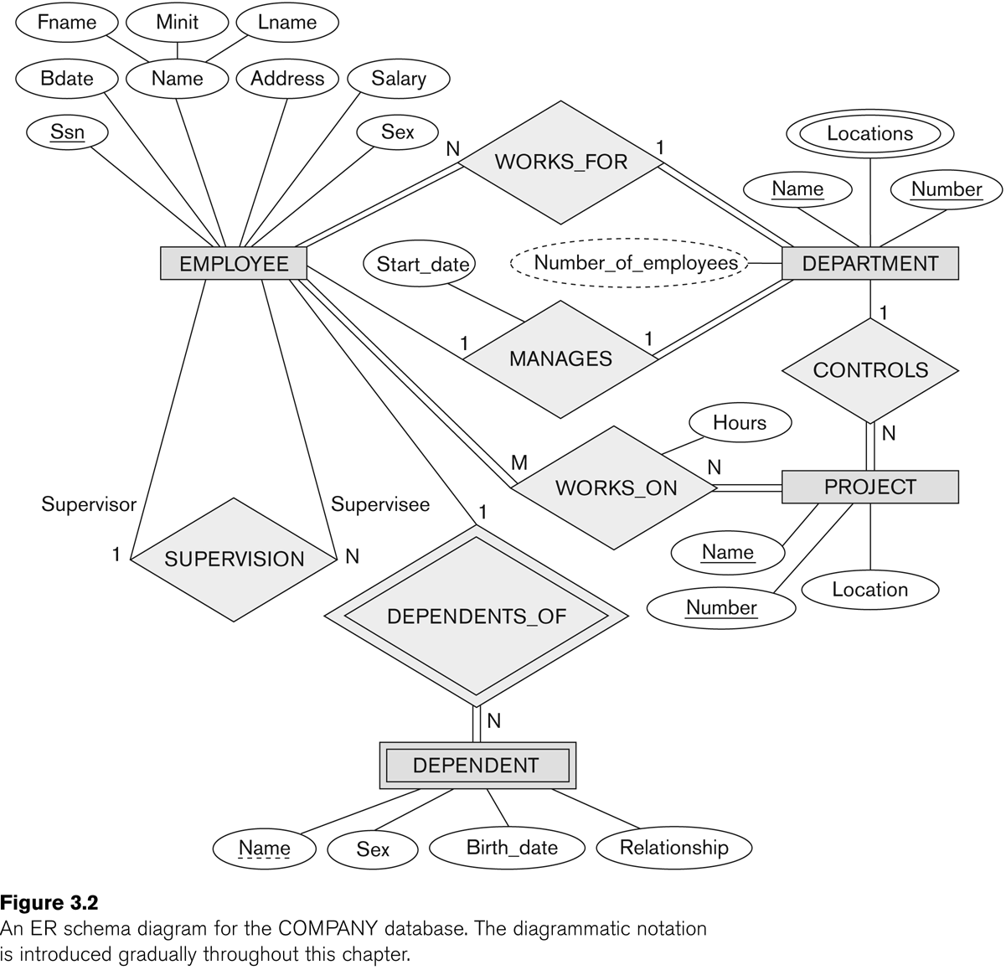
Example

Slide 6
University Management System
Different College / institute are there under the university
Each College has different departments that manages information related to courses
Students are enrolled in a course
Courses offers different subjects
Faculties teaches subjects in different courses
One faculty in each department is the head of that department
One faculty is the director of the college / institute.
Course has exam, students appear for the exam and get grades for the same

Slide 7
Draw an ER Diagram for the Library Management System.
In a Library different types of books are purchased for the students to refer.
Books are categorized by different authors and publishers.
Student registers in the library and can issue books.
Librarian manages student details.

Slide 8
Project Management System of an IT Company
A company handles different projects from clients
Manages client information
Project contains different task and duration
Employee has to maintain the daywise timesheet for the task completed

Slide 9
Pharmacy Store Management
Store has many branches, pharmacist as an employee in it
Drug manufacturing company supplies drugs at different branches
Patient come with a doctor’s prescription
Pharmacist sell drugs
The store manages information relate to the doctor, the patient as a customer, the manufacturer and the pharmacist as an employee – branch wise

Slide 10
